Slide 1


DATA HIDER
A MINI PROJECT REPORT Submitted by
Anthoni Thomas R (732119205005)
LakshmanaKumar V (732119205024)
Pon Pandian P (732119205038)
Sekar S (732119205047)
Project Guide
Mr.T.Krishnakaarthik,M.E.,(Ph.D).,
Professor,
Department of Information Technology

Slide 2
ABSTRACT
Steganography is the art of hiding the fact that communication is taking place, by hiding information in other information.
Many different camera file formats can be used, but digital images are the most popular became of their frequency on the Internet.
For hiding secret information in images, there exists a large variety of stegnography techniques some are more implex than others and all of them have respective string and weak points.
This project hides the message with in the image For a more secure approach, the poject it allows user to choose the hits for replacement instead of LSB replacement In the Image viewer select the cover image with the series text or text file and hide it in to the image with the hit employment choice.

Slide 3

INTRODUCTION
The growing use of Internet needs to take attention while we send and receive personal information in a secured manner.
For this, there are many approaches that can transfer the data into different forms so that their resultant data can be understood if it can be returned back into its original form. This technique is known as encryption.

Slide 4
EXISTING SYSTEM
In the existing system reversible data hiding technique the image is compressed and encrypted by using the encryption key.
The data to hide is embedded in to the image by using the same encryption key.
The user who knows the secret encryption key used can access the image and decrypt it after extracting or removing the data hidden in the image.
After extracting the data hidden in the image then only can be the original image is retrieved.

Slide 5
DRAWBACKS OF EXISTING SYSTEM
One of steganography’s disadvantages is that there is large overhead to hide very tiny amounts of information.
Hiding short messages within wide text is limited by the size of the extensive text.
Text files cleanly aren’t big enough to covet more complex data like images or audio files.

Slide 6
PROPOSED SYSTEM
The proposed system showed high hiding rates with reasonable imperceptibility compared to other steganographic systems.
Block Diagram of Embedding Secret Image In the authors present according to texture analysis in low frequency sub-band of Discrete Wavelet Transform (DWT),an adaptive image hiding algorithm.
proposed the DCT(Discrete Cosine Transform) is a mathematical transformation that takes a signal and transforms it from spatial domain into frequency domain.
We have chosen DCT because JPEG and MPEG use the DCT transform to concentrate image information by removing spatial data redundancies.

Slide 7
ADVANTAGES OF PROPOSED SYSTEM
Fast data services.
Low data transfer costs.
More functionality possible(new devices with better displays and browser functionality).
Higher Security mechanisms.
There is no time constrains.
we can do banking from any place with less time.
There is no risk of disclosure.

Slide 8
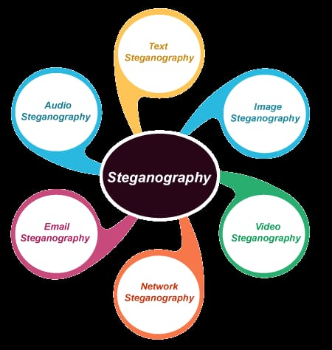
TYPES OF STEGANOGRAPHY

Slide 9

PROJECT OBJECTIVES
In this project we primarily concentrated on the data security issues when sending the data over the network using steganographic techniques.
The main objectives of our project are to product security tool based on steganography techniques to hider message carried by stego-media which should not be sensible to human beings and avoid drawing suspicion to the existence of hidden message.

Slide 10
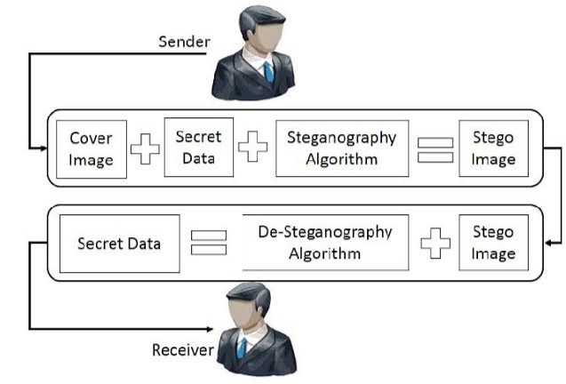
OVERVIEW OF IMAGE STEGANOGRAPHY
The overall process of the image steganography is to hide the sensitive data or information inside a cover image without the degradation of the original image.
Hence providing the security by which no unauthorized person can access the information which is hidden.
SENDER AND RECEIVER DIAGRAM

Slide 11
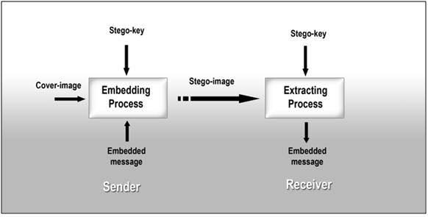
BACKGROUND PROCESS
Hiding information into a medium requires following elements.
The cover medium(C) that holds the secret message.
The secret message (M), it can be a plain text, an image file or any other type of data.
The steganography techniques which are going to be used to hide the information
A stego-key (K) which will be used for hiding and un-hiding the message.

Slide 12
SYSTEM REQUIREMENTS
HARDWARE REQUIREMENTS
Processor : IntelCore-i3
RAM : Min 2gb
SOFTWARE REQUIREMENTS
Operating System : Windows10
Tool : Python IDLE,Command Prompt,PIP
Language : Python
SOFTWARE DESCRIPTIONS
The execution phase was developed based upon three phases. The different phases are encryption, decryption and implementation phases.

Slide 13
MODULES
ENCRYPTION
DECRYPTION
APPLICATION DESIGN
MODULES DESCRIPTION
ENCRYPTION - Hiding Data into a Image or Audio file using Encryption Algorithm.
DECRYPTION - Extracting Data from Encrypted file using Decryption Algorithm.
APPLICATION DESIGN - Creating a Application which will cover all the functions of Steganography like Encryption and Decryption.

Slide 14
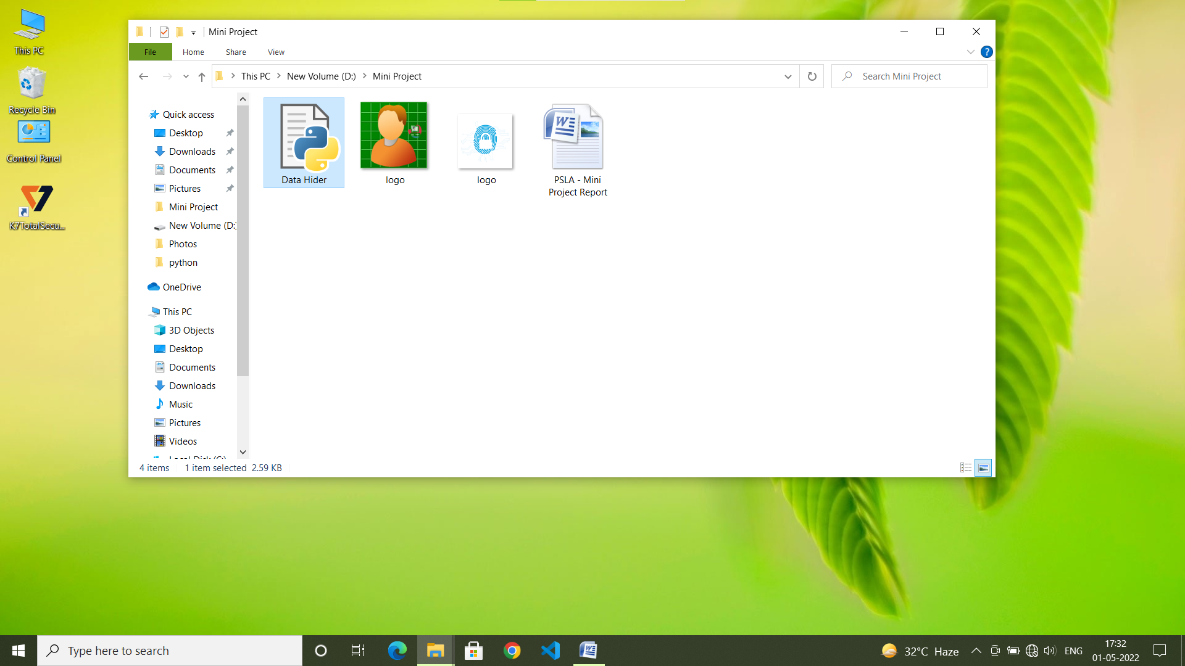
OUTPUT
FILE LOCATION
This page shows all files are saved in one common folder where we can uses those files whenever we want. open the Data Hider File to open the index of the project.

Slide 15
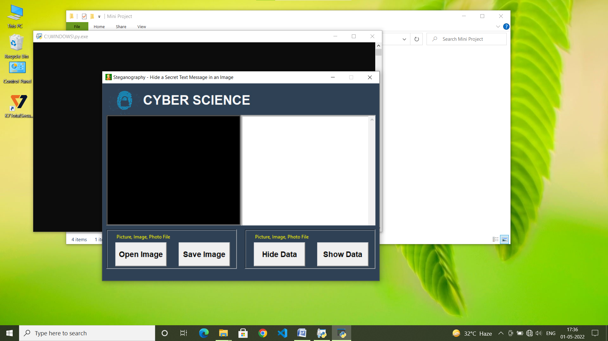
SENDER END
Above Screenshot displays the Sender’s Interface. This interface consisting of both encryption and Decryption process. First we execute the Encryption process below

Slide 16
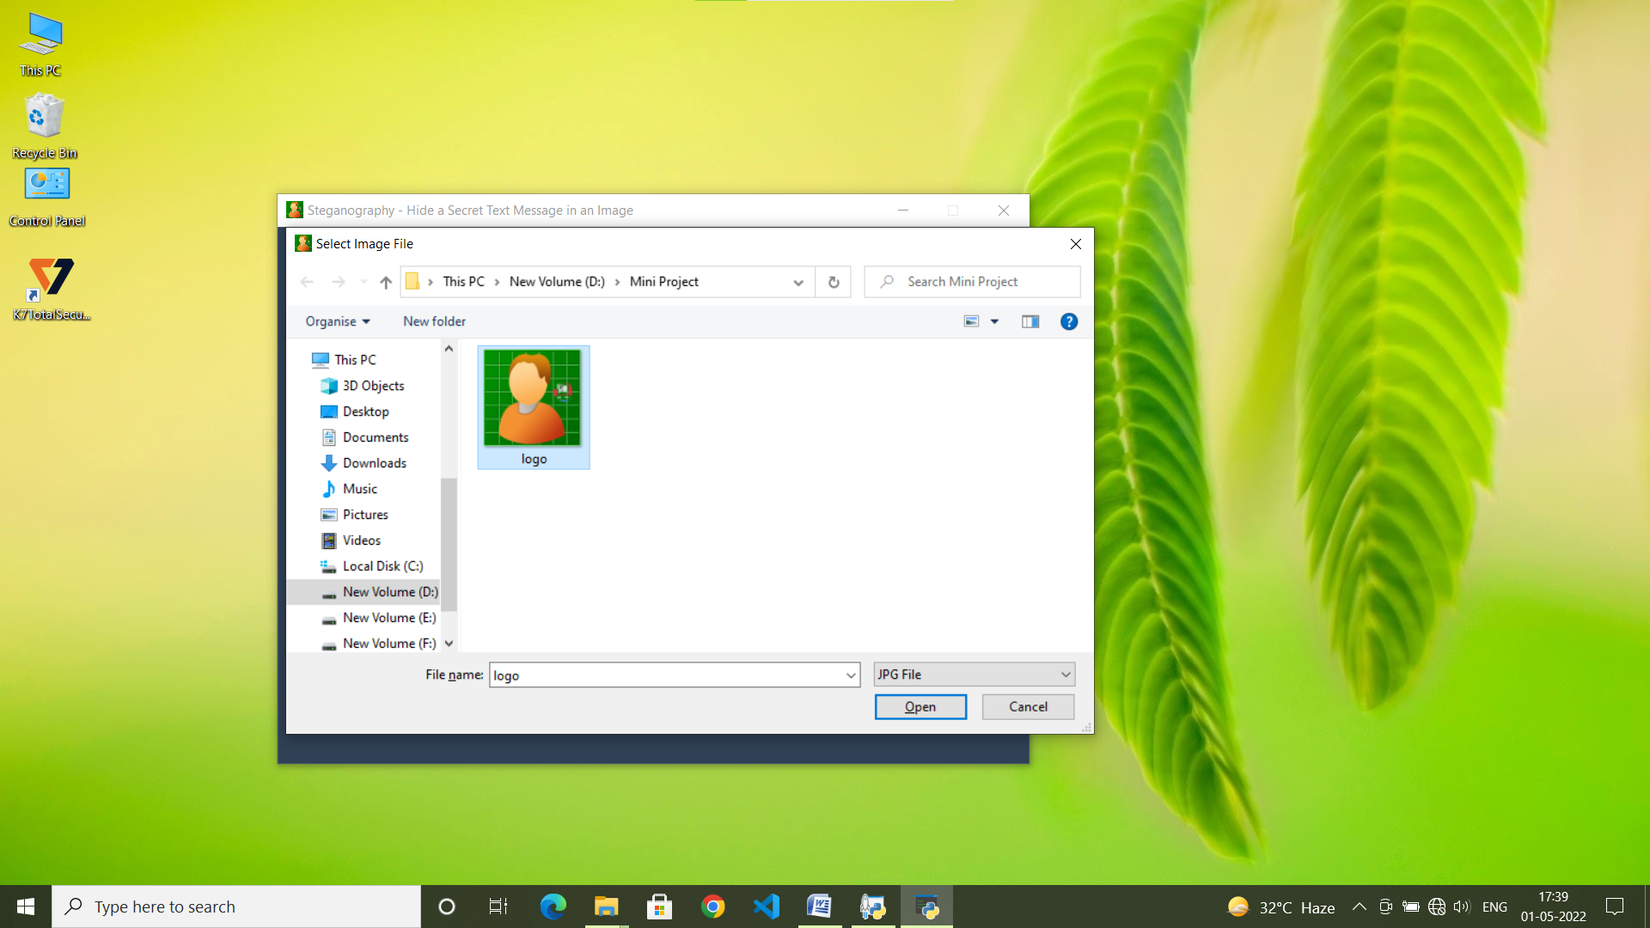
SELECT COVER IMAGE
This Screenshot displays the process of selecting the cover image. In the Homepage we can click the OPEN IMAGE option to select the cover image in a particular location. The main thing is the cover image should be in the mentioned formats like JPG,JPEG,BMP,GIF etc.

Slide 17
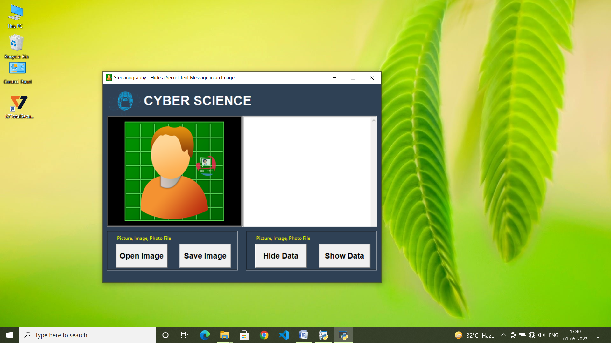
COVER IMAGE
The cover image will be displayed in the left box in the above screen shot.Select the directory path where the extracted secret message needs to be saved in the extraction directory then click on SAVE IMAGE button. The Cover image used for hide the text in images and hidden text messages can be read by Only stegno users.

Slide 18
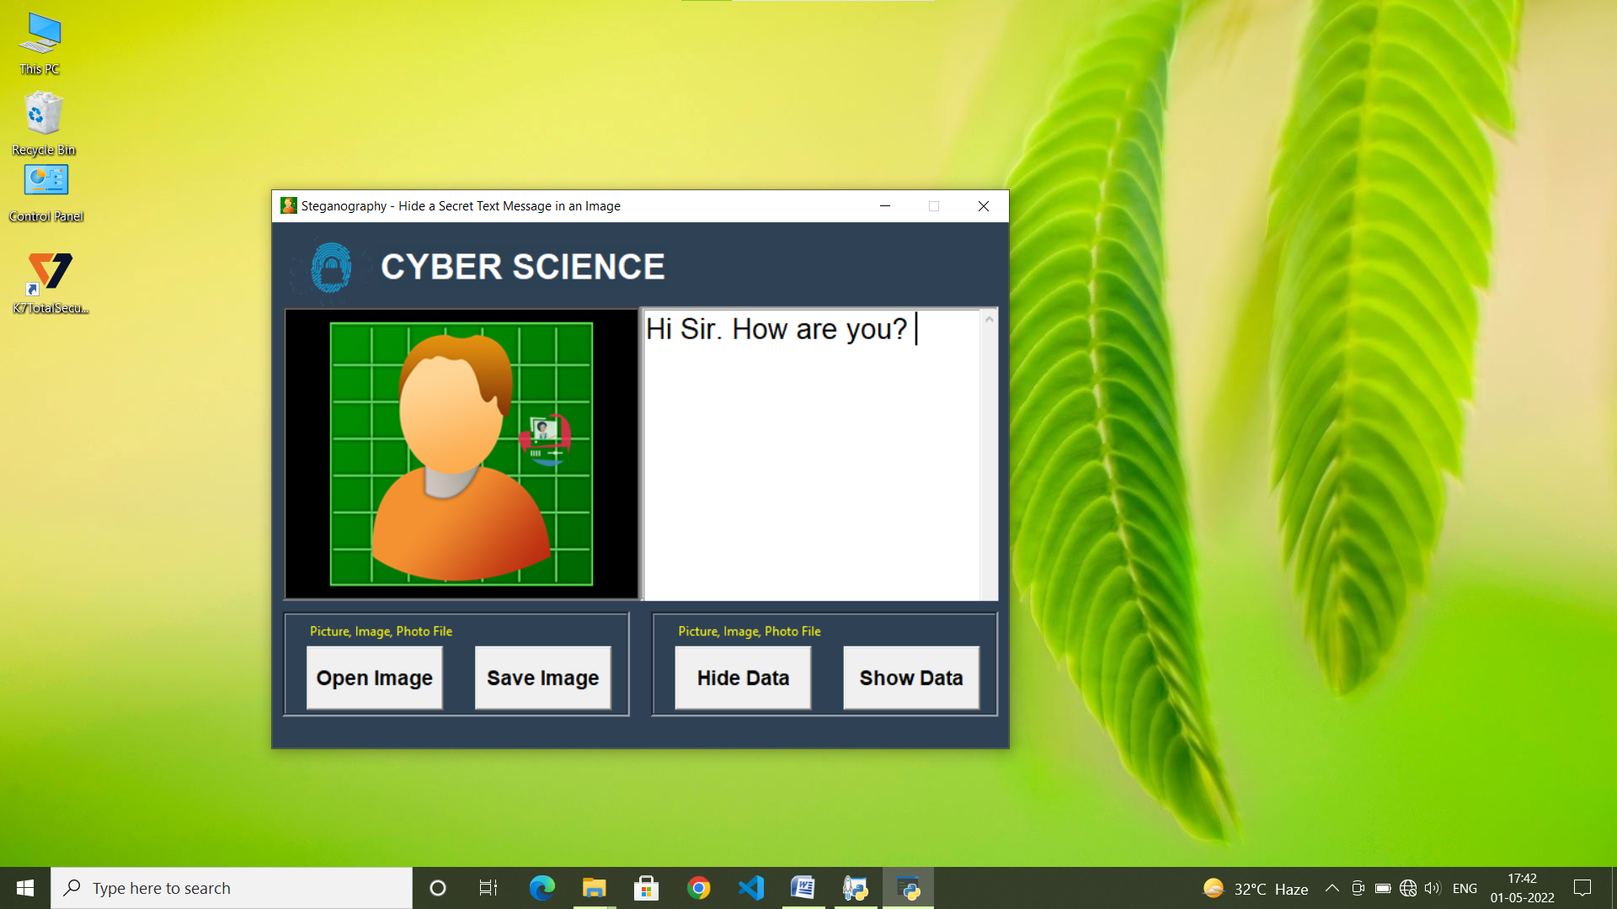
SECRET MESSAGE
The text which is to be hidden can be added by typing or by loading it from a TXT file. After hiding the text in the image,the final output image will be saved in PNG format. The user interface of the software is easy to understand.

Slide 19
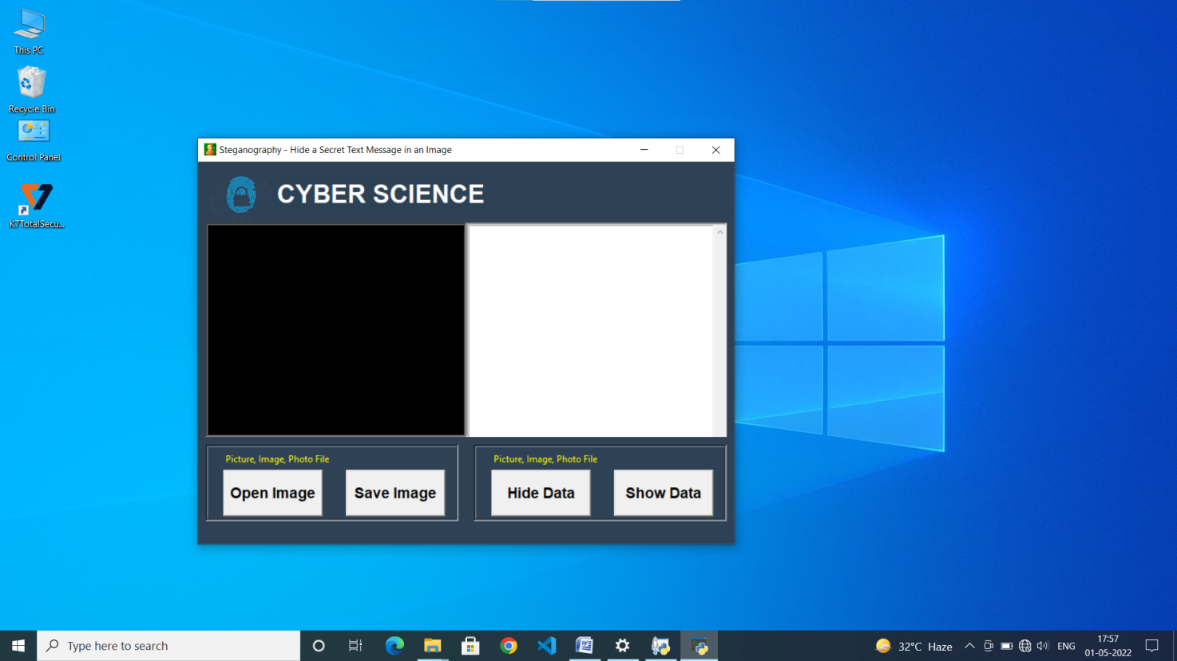
RECEIVER END
The above screenshot displays the Receiver End. This interface used to decode process. The encrypted image should be uploaded here and the decode that image to get the secret message.

Slide 20
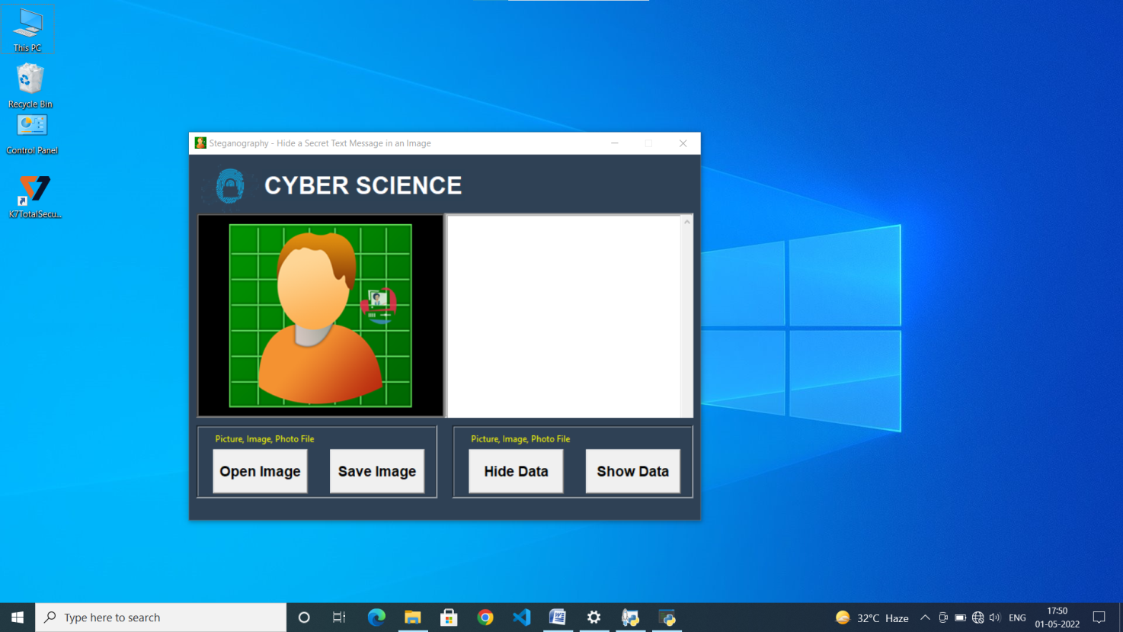
SELECT RECEIVED IMAGE
The Receiver Select the received image which is encrypted by the Sender and open it. This image is embedded with the secret message. The decoding process will be displayed in next screenshot.

Slide 21
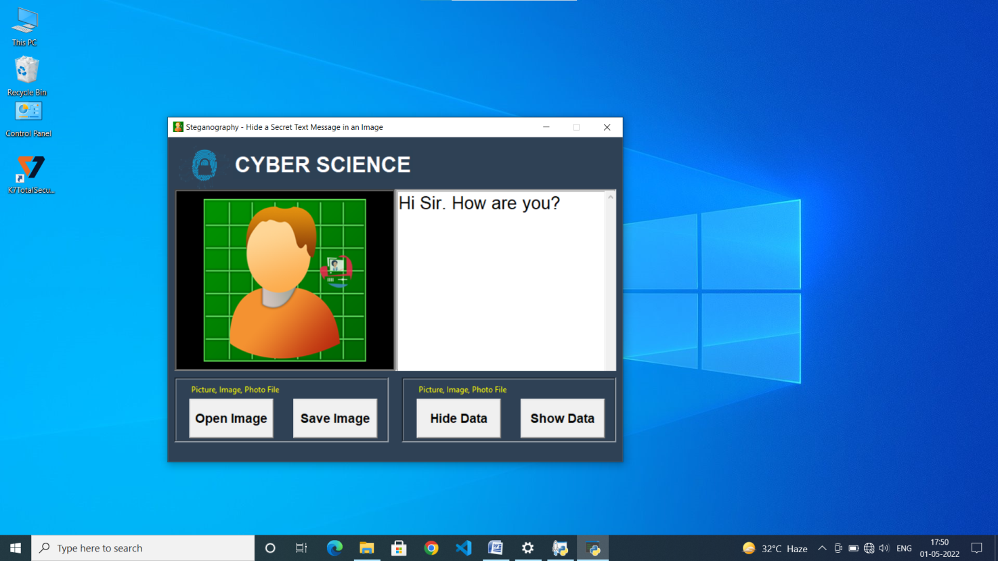
DECRYPTION PROCESS
After uploading the image then click the SHOW DATA option .This will show the decrypted original secret message which is send by the sender.

Slide 22
CONCLUSION
Although only some of the main image steganographic techniques were discussed in this document.
All the major image file formats have different methods of hiding messages, with different strong and weak points respectively.
The major limitation of the application is designed for images cover files. It accepts only images as a carrier file.
The future work on this project is to improve the compression ratio of the image to the text.

Slide 23
REFERENCES
WIKIPEDIA https://en.m.wikipedia.org/wiki/Steganography
W3Schools https://www.w3schools.com

Slide 24


